Slide 1
HCIG Hardware Signal Analysis
Ty Ahrens, Gabe Adams, Harrison Simpson
9/15/2026
HCIG
Hardware Signal Analysis

Slide 2

Announcements
  Career Fair
    10am – 2pm @ Hoop Sept 17th
  Cyber Eagles: Enumeration & Windows Security
    11am – 12pm Bruner 327 Sept 17th
  OCIG: Enumeration
    6pm – 7pm Bruner 228 Sept 17th
  Hike to Cummins Falls Gorge
    10am Cummins Fall Park Sept 19th
  MITRE eCTF General Interest Meeting
    TBD
9/15/2026
HCIG
Hardware Signal Analysis

Slide 3
Overview
Introduction
UART
SPI
I2C
9/15/2026
HCIG
Hardware Signal Analysis

Slide 4
Introduction
Communication between electronic devices is similar to communication between humans.
Both parties need to speak the same language in order to communicate. In electronics, these languages are called communications protocols.
9/15/2026
HCIG
Hardware Signal Analysis

Slide 5
Introduction
In parallel communication, all the bits of data are transmitted simultaneously on separate communication lines
In serial communication, the data bits are transmitted simultaneously on separate communication lines.
9/15/2026
HCIG
Hardware Signal Analysis

Slide 6
Introduction
Serial communication used two methods:
  Asynchronous
  Synchronous
Asynchronous:
  Transfers single byte at a time
  No need of clock signal
  Example: UART (Universal Asynchronous Receiver Transmitter)
Synchronous
  Transfers a block of data (characters) at a time.
  Requires a clock signal
  Example: SPI (Serial Peripheral Interface), I2C (Inter Integrated Circuit).
9/15/2026
HCIG
Hardware Signal Analysis

Slide 7
Introduction
Two Methods of Serial Communication
Asynchronous:
Transfers single byte at a time
No need of clock signal
Example: UART (Universal Asynchronous Receiver Transmitter)
Synchronous:
Transfers a block of data (characters) at a time.
Requires a clock signal
Example: SPI (Serial Peripheral Interface), I2C (Inter Integrated Circuit).
9/15/2026
HCIG
Hardware Signal Analysis

Slide 8
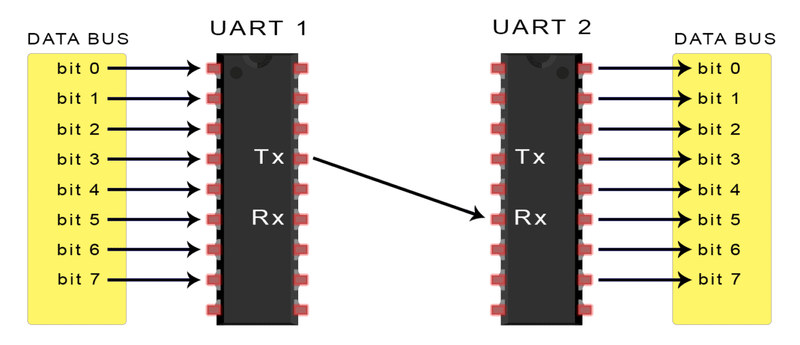
UART Communication
In UART Communication, two UARTs communicate directly with each other
Only two wires are needed to transmit and receive data.
  Tx -> Rx
  Rx <- Tx
Instead of a clock signal, the transmitting UART adds start and stop bits to data packets.
  The bits at the beginning and end of these packets say when to start reading/stop reading
9/15/2026
HCIG
Hardware Signal Analysis

Slide 9
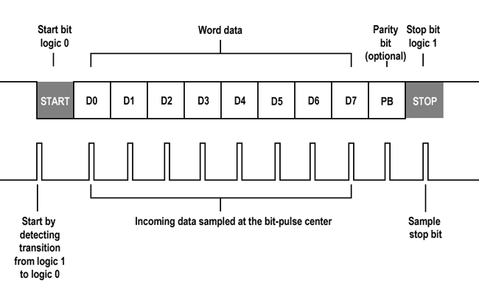
UART Communication
After the UART receives the data from another source, it then adds a start bit, a parity bit, and a stop bit(s) to the packet.
The packet is then output serially, bit by bit at the Tx pin to the Rx pin on another board.
This Rx pin then transforms this packet back into
9/15/2026
HCIG
Hardware Signal Analysis

Slide 10
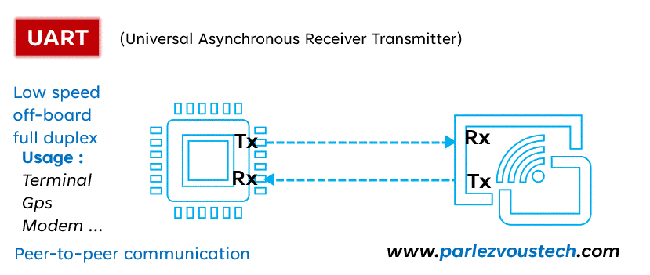
UART Communication
9/15/2026
HCIG
Hardware Signal Analysis

Slide 11
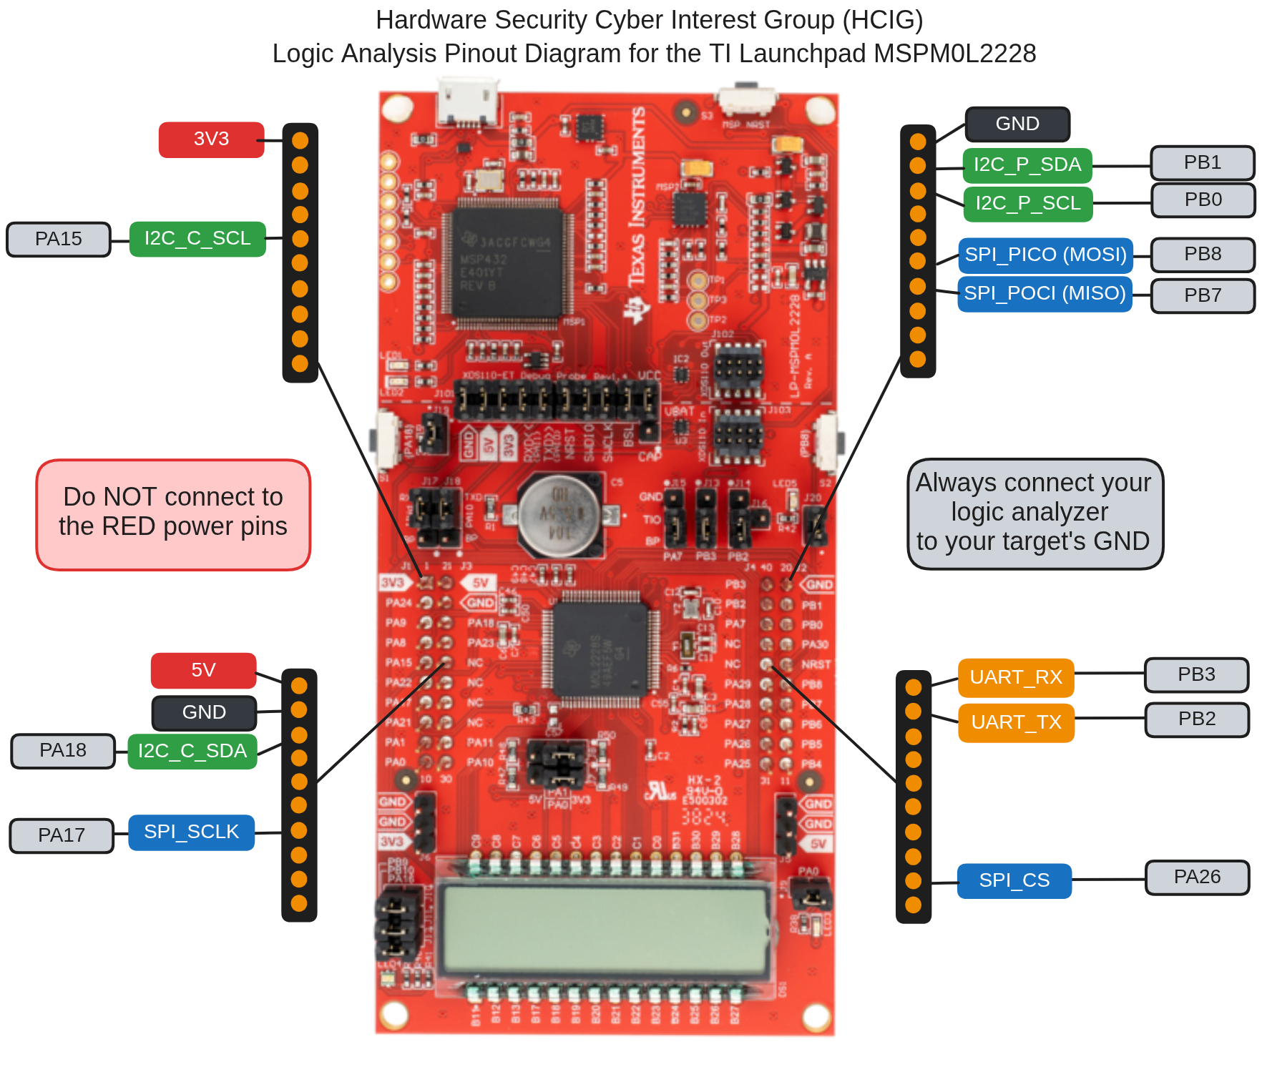
Lab #1
Follow setup instructions found in Discord
View UART Communication via Saleae
9/15/2026
HCIG
Hardware Signal Analysis

Slide 12
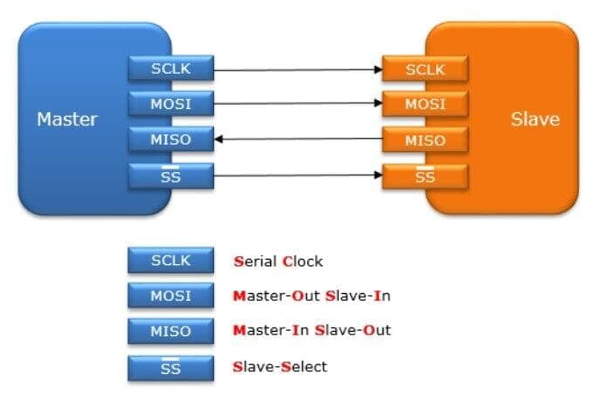
SPI Communication
In SPI communication, devices connecting are in a master-slave relationship
The master acts as the controlling device while the slave takes the instruction
  Ex: Microcontroller -> Sensor or display
There can be only one master device, but it can connect to multiple slave devices
9/15/2026
HCIG
Hardware Signal Analysis

Slide 13
SPI Communication
Slave Clock Pin (SCLK)
The clock signal synchronizes the output stream of bits from the master to the sampling bits of the slave.
Master Out Slave In (MOSI)
Transmits bits from the master controller to a slave device.
Master In Slave Out (MISO)
Transmits bits from the slave device back to the master device.
Slave Select (CS/SS)
The master can select what slave to communicate to, which allows for multiple slaves to be connected to one master.
9/15/2026
HCIG
Hardware Signal Analysis

Slide 14
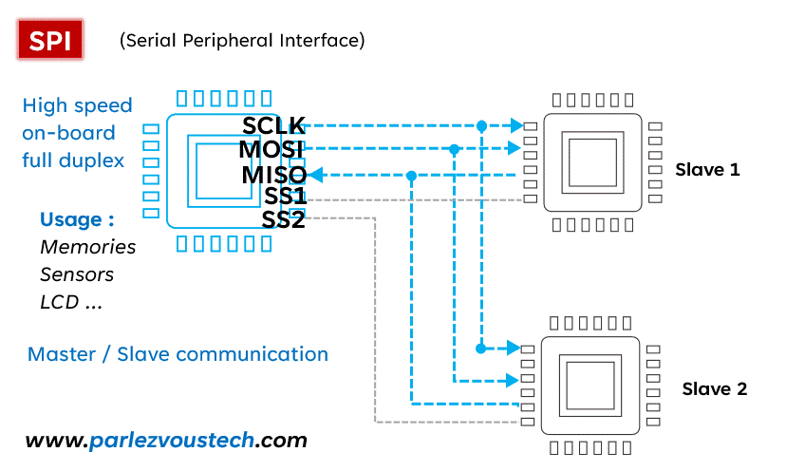
SPI Communication
9/13/2026
HCIG
Hardware Signal Analysis

Slide 15
Lab #2
Follow setup instructions found in Discord
View SPI Communication via Saleae
9/13/2026
HCIG
Hardware Signal Analysis

Slide 16
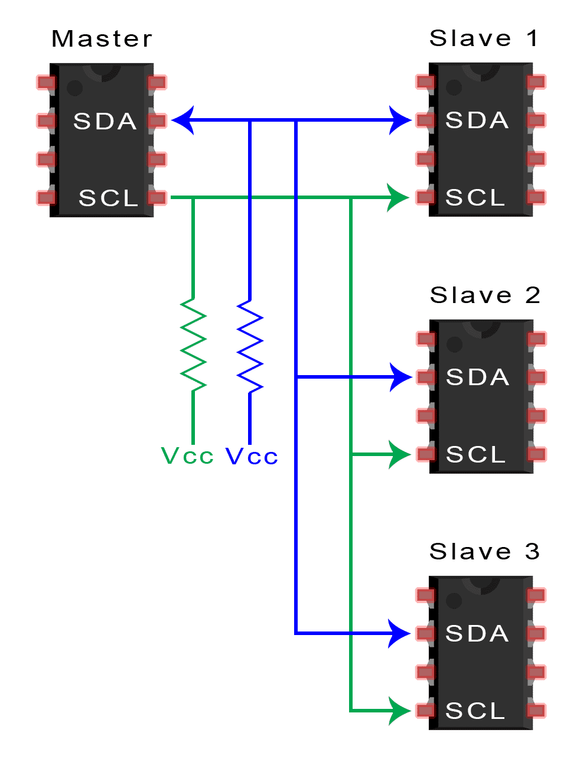
I2C Communication
I2C goes to combine the better features of SPI and UART.
With I2C, you can still connect multiple slaves to a single master (like SPI).
You can also have multiple masters controlling a single or multiple slaves.
9/13/2026
HCIG
Hardware Signal Analysis

Slide 17
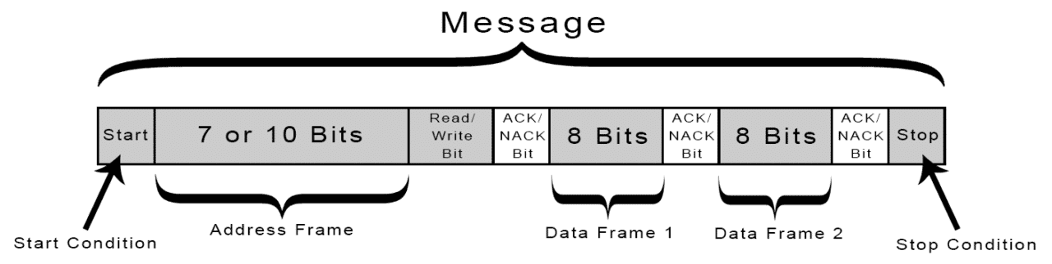
I2C Communication
Data is transferred using messages. These are broken up into different parts like the following:
9/13/2026
HCIG
Hardware Signal Analysis

Slide 18
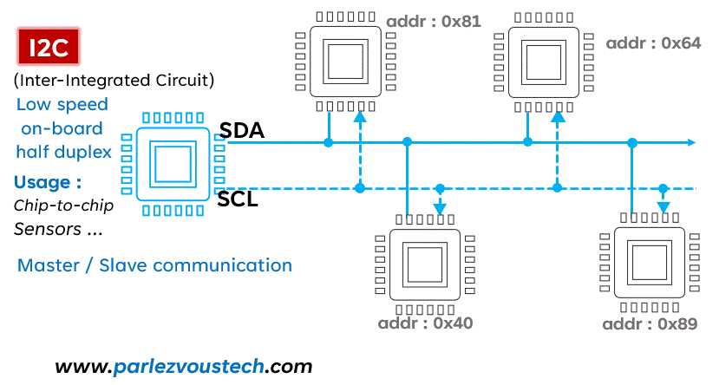
I2C Communication
9/13/2026
HCIG
Hardware Signal Analysis

Slide 19
Lab #3
Follow setup instructions in Discord
View I2C Communication via Saleae
The master SDA/SCL is I2C_C_SDA & I2C_C_SCL (C for Controller)
The slave SDA/SCL is I2C_P_SDA & I2C_P_SCL (P for peripheral)
9/15/2026
HCIG
Hardware Signal Analysis

Slide 20

Join Us!
Mentor Application
Discord
9/15/2026
HCIG
Intro and Basics

